Slide 1
18-799: Applied Computer Vision Spring 2026
Image Processing:
Image Resizing

Slide 2
Objectives
In today’s class we will learn
What is Image Resizing
What is image pyramid
Application of Image pyramid

Slide 3
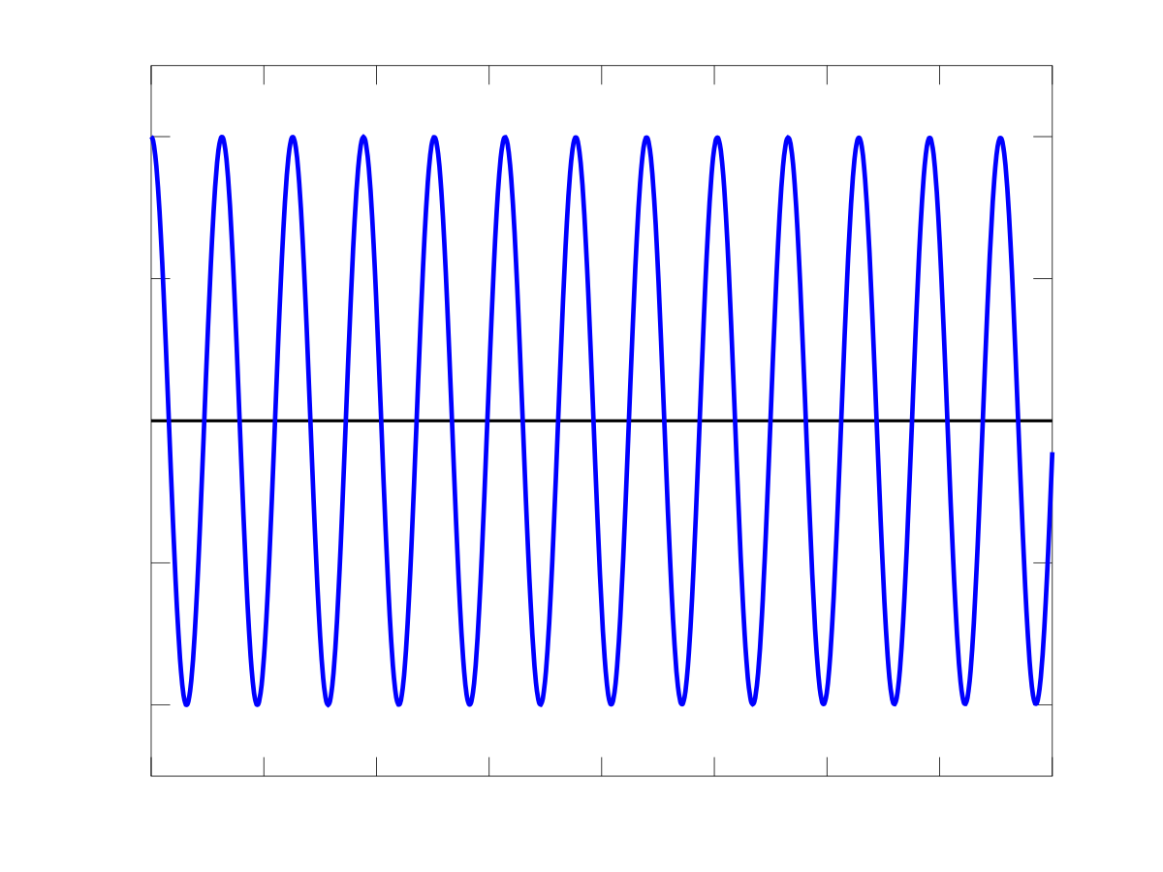
f(x)

Slide 4
f(x)

Slide 5
g(x)
f(x)

Slide 6
f(x)

Slide 7

Aliasing
g(x) is an “alias” of f(x)
f(x)

Slide 8
Aliasing
g(x) ~= f(x)
f(x)
No aliasing in this case
Notes:
Doesn’t happen in this case, how come?

Slide 9
Sampling and the Nyquist rate
< 1 sample per cycle
> 10 samples per cycle
To avoid aliasing
≥ two samples per cycle
This minimum sampling rate is called the Nyquist rate

Slide 10
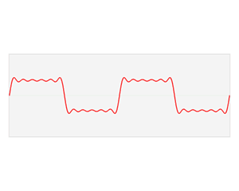
But this only works for sine waves, right?
Fourier transform
Decomposes any signal or image into weighted sum of sines and cosines
To avoid aliasing
sampling rate ≥ 2 * max frequency present in the image (Nyquist rate)

Slide 11
Fourier Transform
Fourier transform
Decomposes any signal or image into weighted sum of sines and cosines

Slide 12
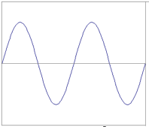
Fourier Series
≈
We want to get this function
Slides: Alyosha Efros

Slide 13
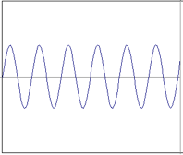
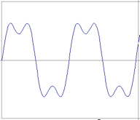
Fourier Series
≈
+
We want to get this function
=
Following slides from Alyosha Efros

Slide 14
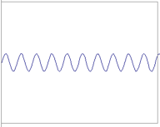
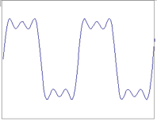
Fourier Series
≈
+
We want to get this function
=

Slide 15
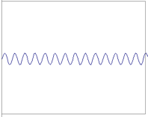
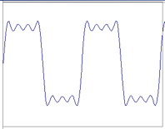
Fourier Series
≈
+
We want to get this function
=

Slide 16
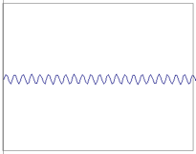
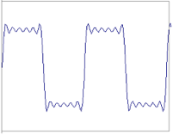
Fourier Series
≈
+
We want to get this function
=

Slide 17
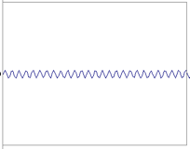
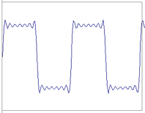
Fourier Series
≈
+
We want to get this function
=

Slide 18
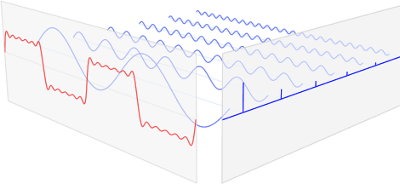
Fourier transform
f(x)
|F(𝟂)|
signal
Fourier transform of signal

Slide 19
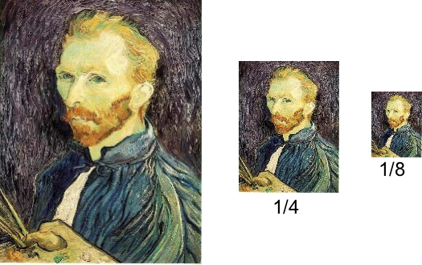
Image Resizing

Slide 20
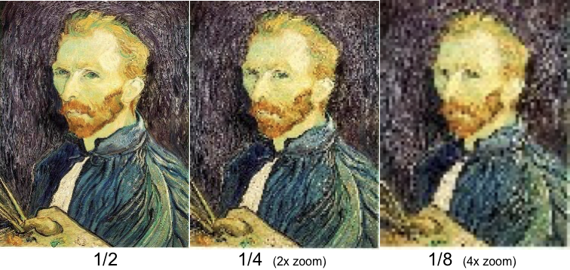
Image Resizing

Slide 21
Image Resizing
Downsampling

Slide 22
Image Resizing
Upsampling

Slide 23
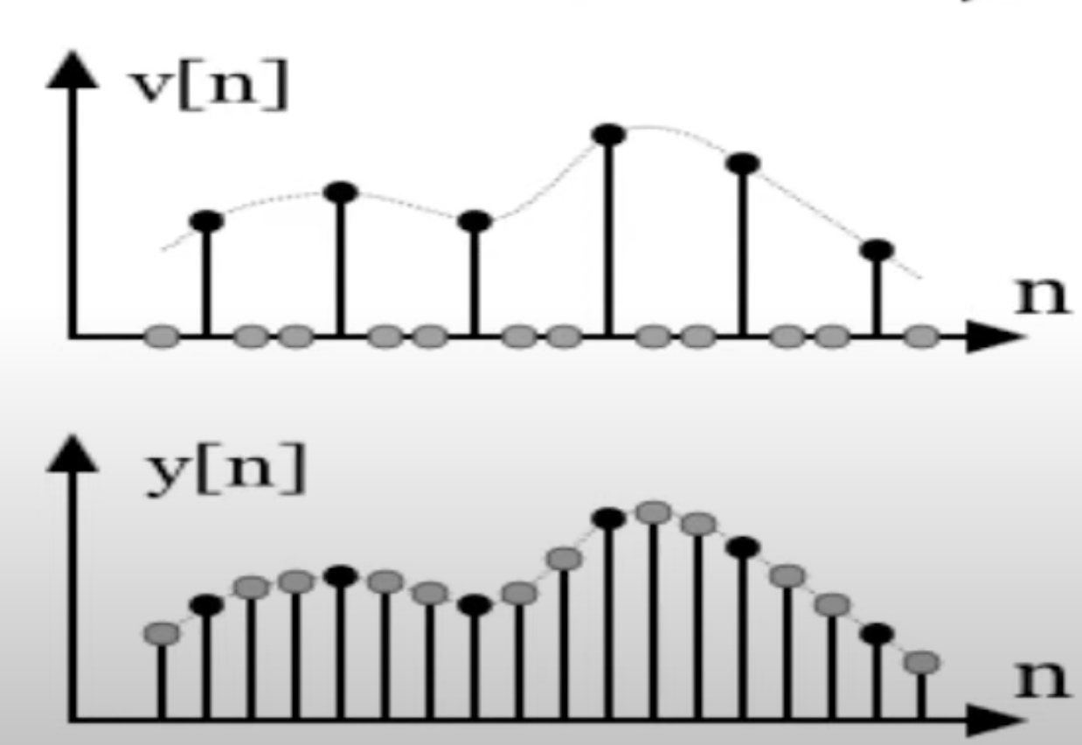
Image Resizing

Slide 24
Image resizing
Upsampling (Nearest Neigbor interpolation)
5 |  | 7 |  | 8
4 |  | 7 |  | 8
3 |  | 2 |  | 1
5 | 7 | 8
4 | 7 | 8
3 | 2 | 1

Slide 25

Upsampling (Linear Interpolation)
5 |  | 7 |  | 8
4 |  | 7 |  | 8
3 |  | 2 |  | 1
5 | 7 | 8
4 | 7 | 8
3 | 2 | 1
$$y=y_{0}+\frac{y_{1}−y_{0}}{x_{1}−x_{0}}\left(x−x_{0}\right)$$

Slide 26
Upsampling (Linear Interpolation)
5 | ? |  |  | 8
4 |  |  |  | 8
3 |  |  |  | 1
5 | 7 | 8
4 | 7 | 8
3 | 2 | 1
$$y=y_{0}+\frac{y_{1}−y_{0}}{x_{1}−x_{0}}\left(x−x_{0}\right)$$

Slide 27
Upsampling (Linear Interpolation)
5 |  |  |  | 8
 | ?
4 |  |  |  | 8
3 |  |  |  | 1
5 | 7 | 8
4 | 7 | 8
3 | 2 | 1
$$y=y_{0}+\frac{y_{1}−y_{0}}{x_{1}−x_{0}}\left(x−x_{0}\right)$$

Slide 28
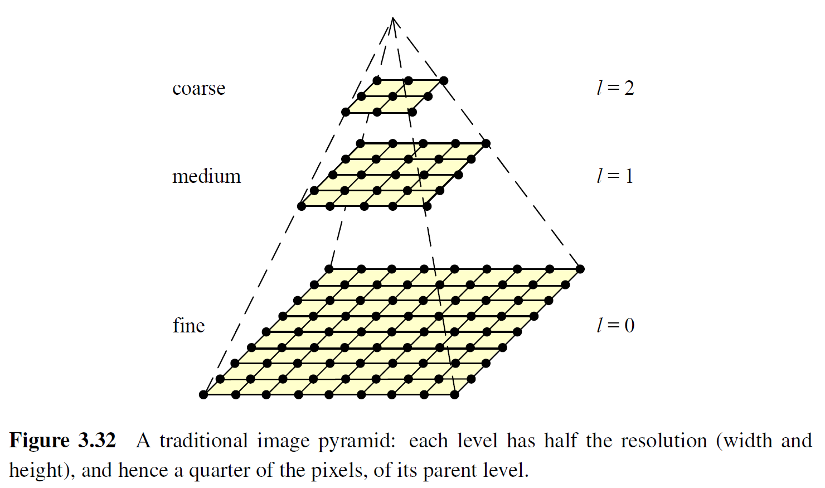
Multi-resolution image pyramids
Commonly used in coarse-to-fine matching, optical flow, stereo, blending, …
… deep neural networks
Notes:
Anything else?

Slide 29

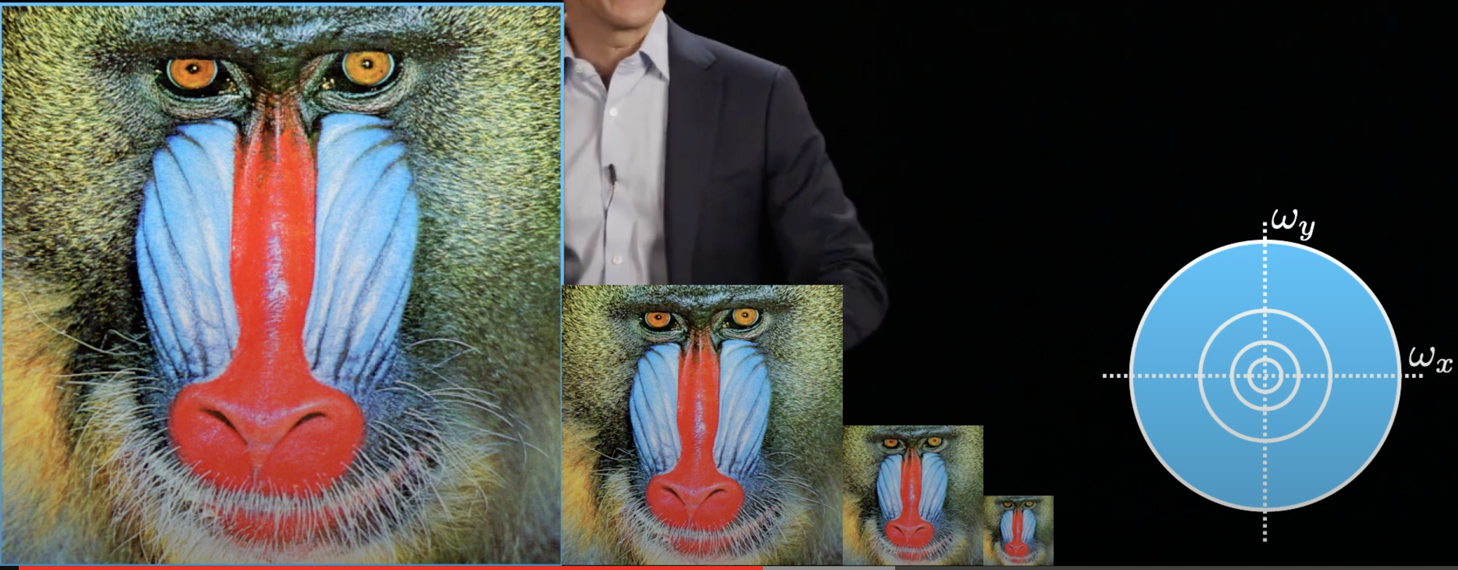
“Gaussian” pyramid

Slide 30
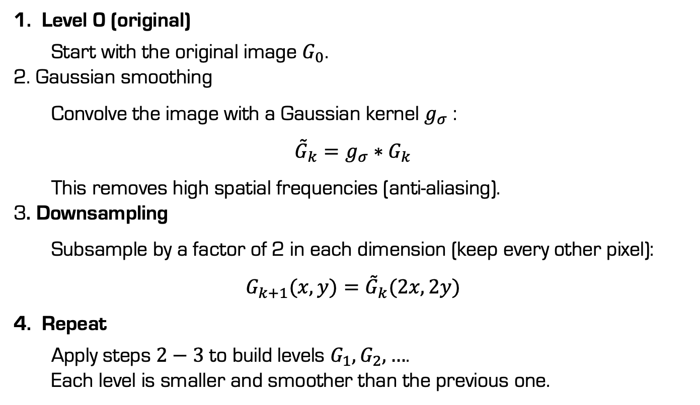
“Gaussian” pyramid
Level 0 (original)
Start with the original image $G_{0}$. 2. Gaussian smoothing
Convolve the image with a Gaussian kernel $g_{σ}$ :
$${\overset{˜}{G}}_{k}=g_{σ}∗G_{k}$$
This removes high spatial frequencies (anti-aliasing). 3. Downsampling
Subsample by a factor of 2 in each dimension (keep every other pixel):
$$G_{k+1}(x,y)={\overset{˜}{G}}_{k}(2x,2y)$$
Repeat
Apply steps $2−3$ to build levels $G_{1},G_{2},…$. Each level is smaller and smoother than the previous one.

Slide 31
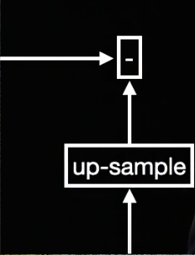
“Laplacian” pyramid

Slide 32
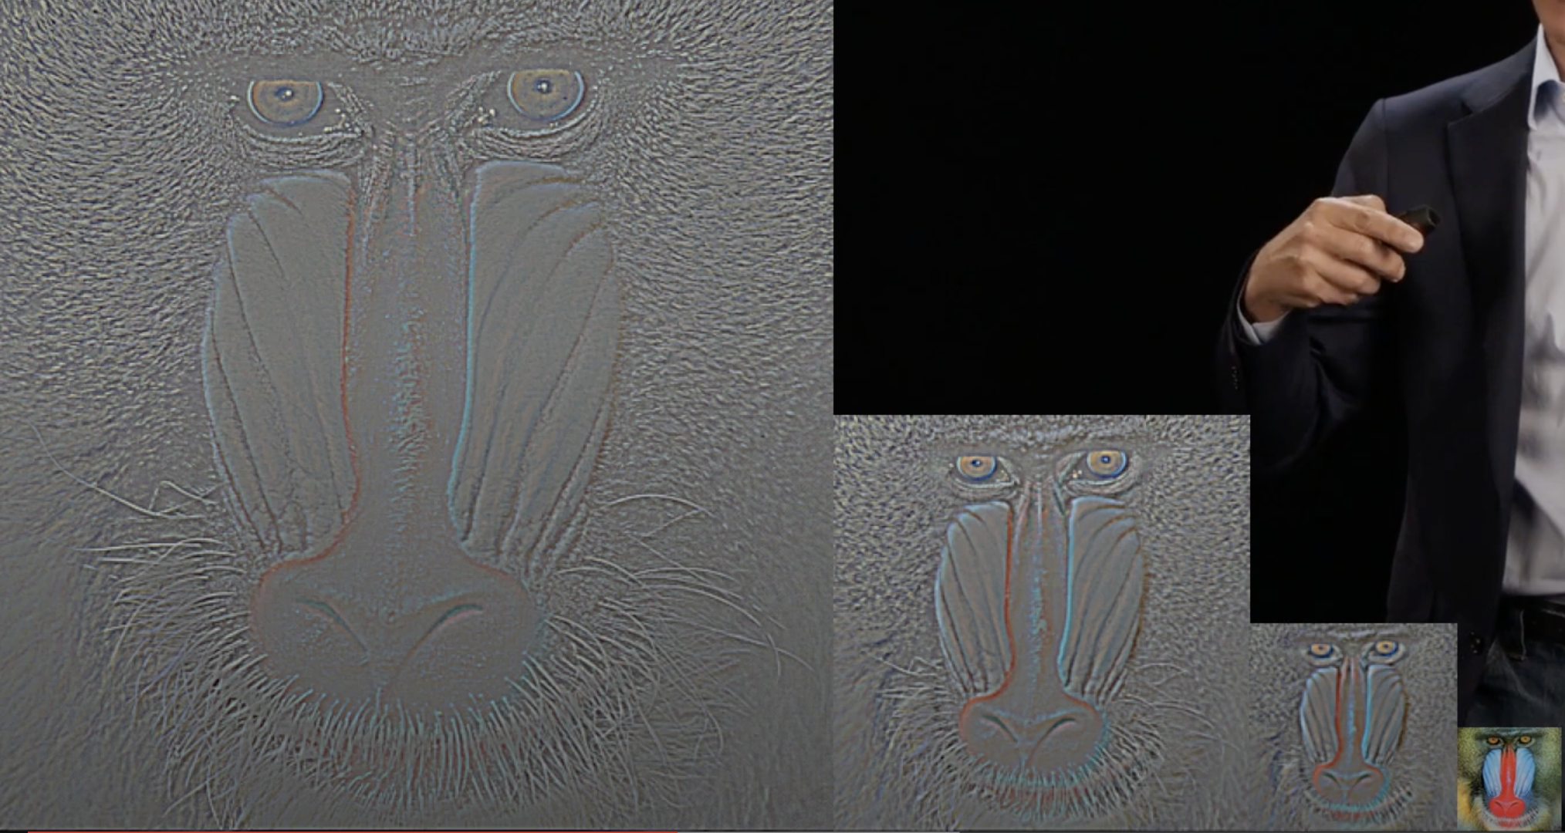
“Laplacian” pyramid

Slide 33
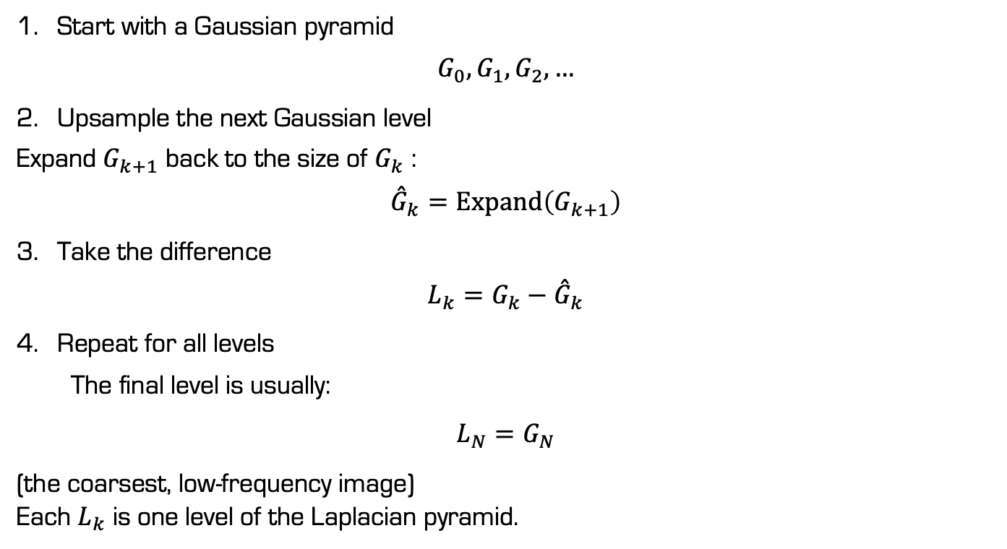
“Laplacian” pyramid
Start with a Gaussian pyramid
$$G_{0},G_{1},G_{2},…$$
Upsample the next Gaussian level
Expand $G_{k+1}$ back to the size of $G_{k}$ :
$${\overset{ˆ}{G}}_{k}=Expand\left(G_{k+1}\right)$$
Take the difference
$$L_{k}=G_{k}−{\overset{ˆ}{G}}_{k}$$
Repeat for all levels
The final level is usually:
$$L_{N}=G_{N}$$
(the coarsest, low-frequency image) Each $L_{k}$ is one level of the Laplacian pyramid.

Slide 34
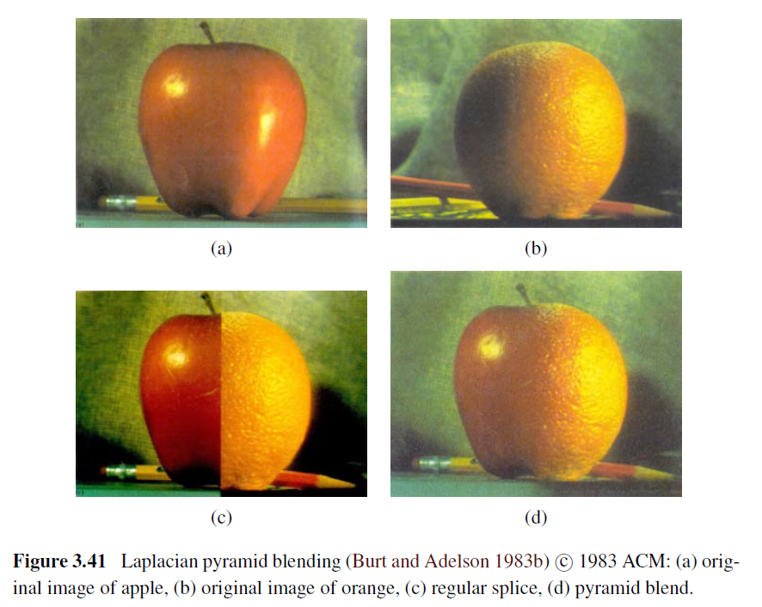
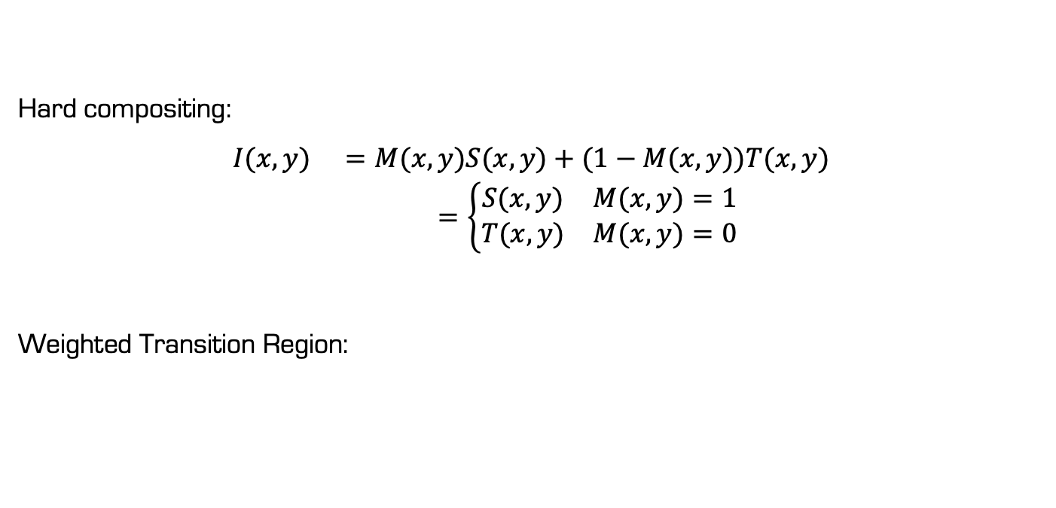
Image blending
Hard compositing:
$$\begin{matrix}I(x,y) & =M(x,y)S(x,y)+(1−M(x,y))T(x,y) \\ & =\left\{\begin{matrix}S(x,y) & M(x,y)=1 \\ T(x,y) & M(x,y)=0\end{matrix}\right.\end{matrix}$$
Weighted Transition Region:

Slide 35
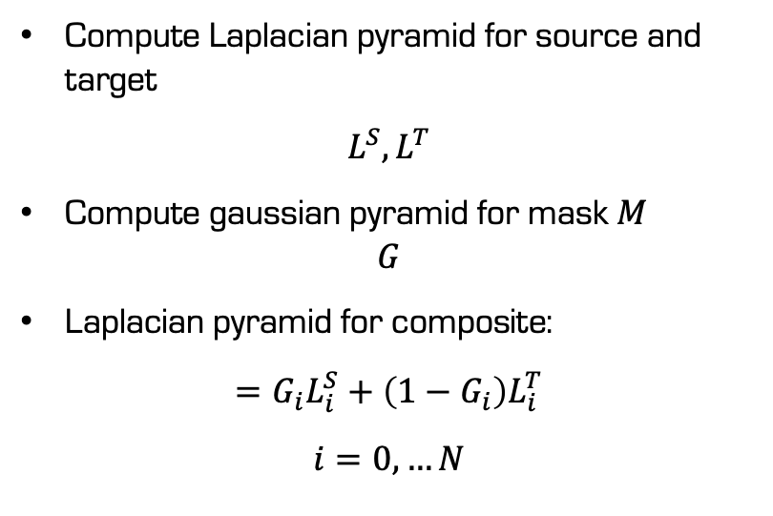
Laplacian pyramid blending
Compute Laplacian pyramid for source and target
$$L^{S},L^{T}$$
Compute gaussian pyramid for mask $M$ $G$
Laplacian pyramid for composite:
$$=G_{i}L_{i}^{S}+\left(1−G_{i}\right)L_{i}^{T}$$
$$i=0,…N$$

Slide 36
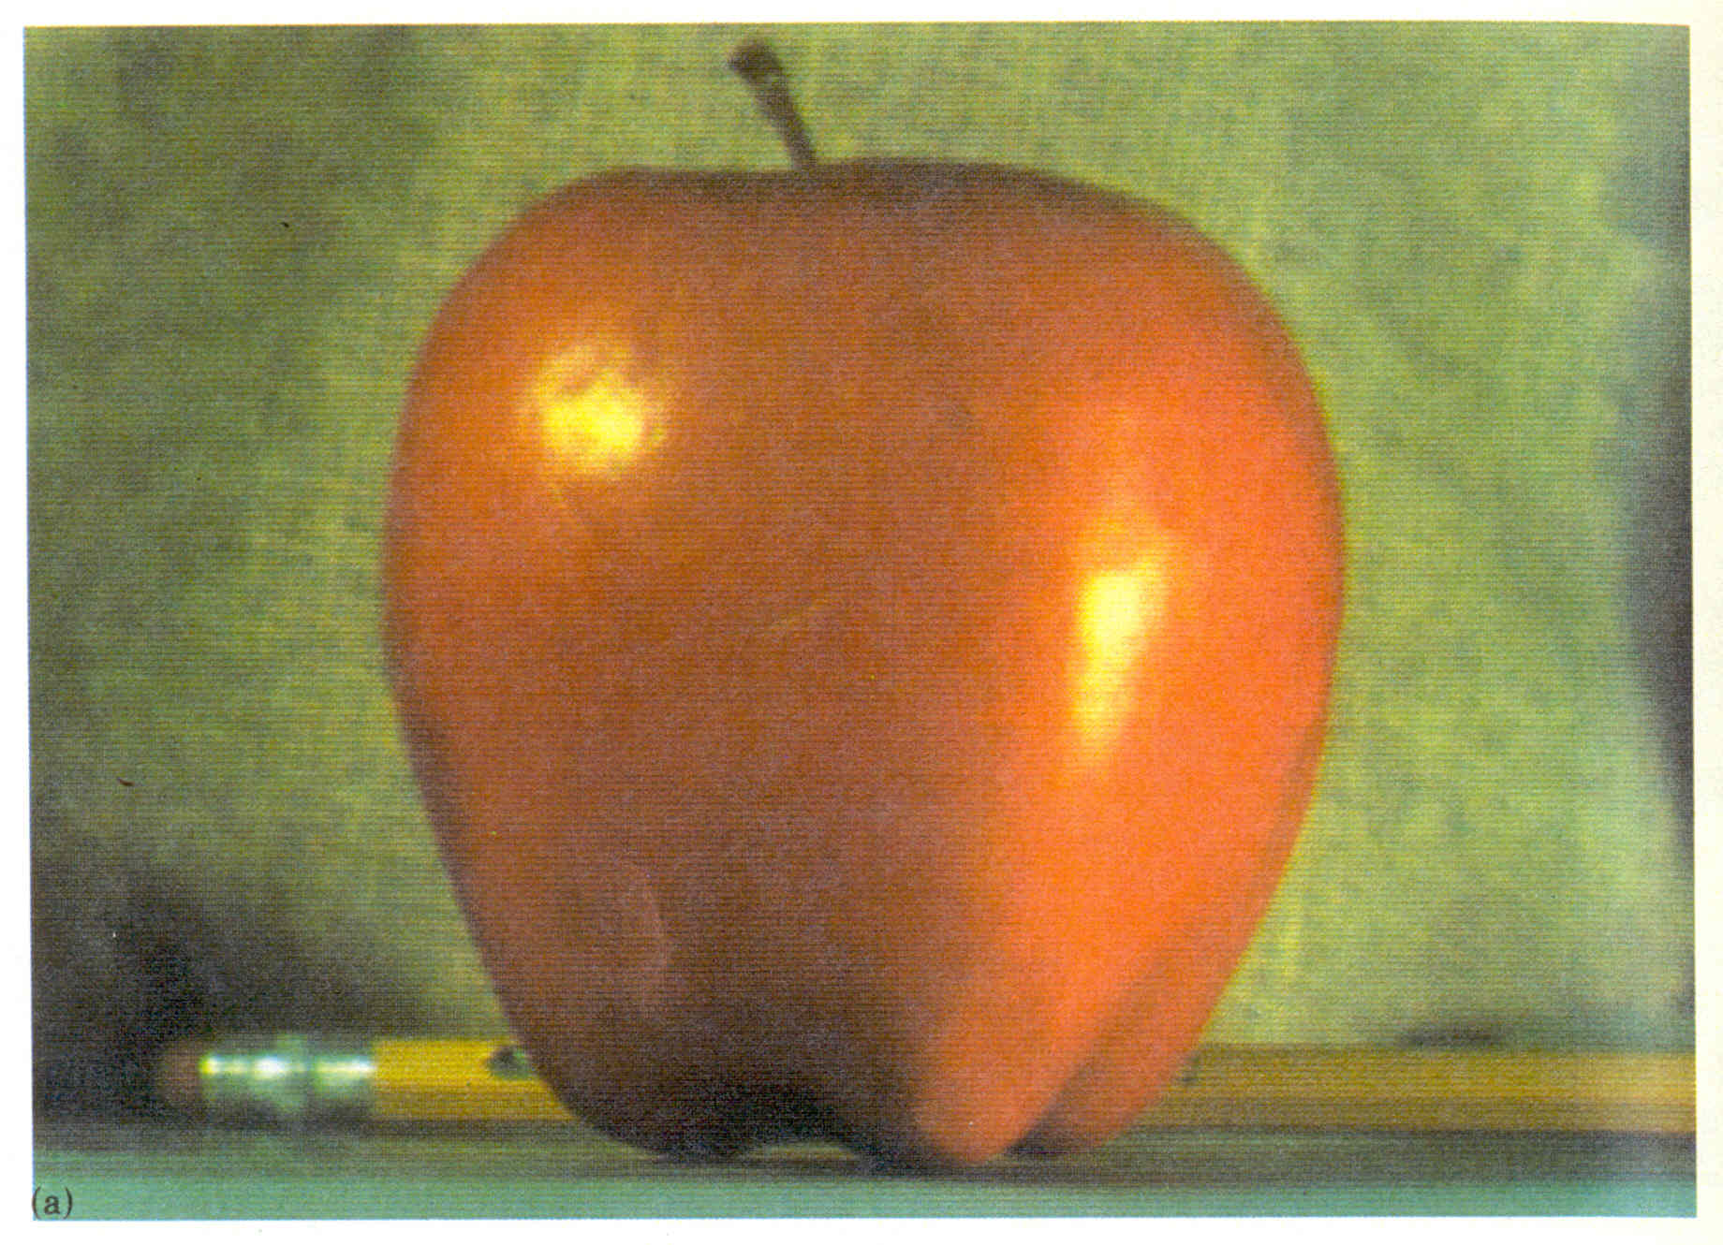
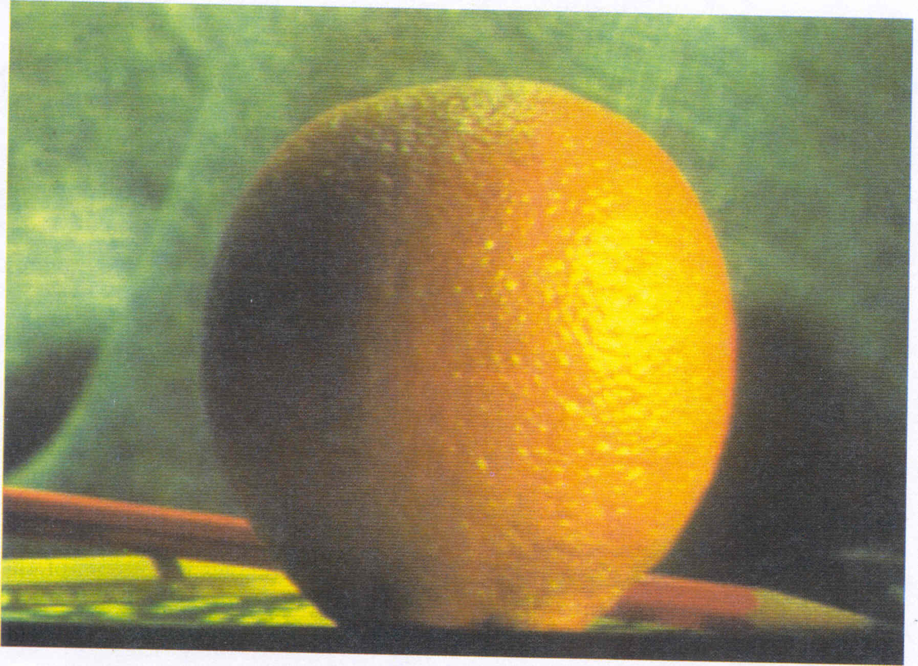
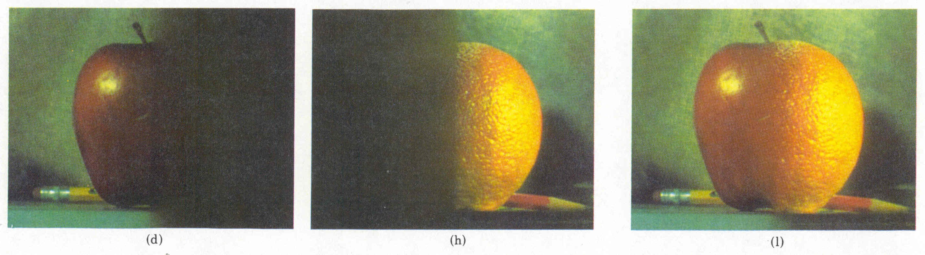
Pyramid Blending
Burt, P. J. and Adelson, E. H., A multiresolution spline with applications to image mosaics, ACM Transactions on Graphics, 42(4), October 1983, 217-236.

Slide 37
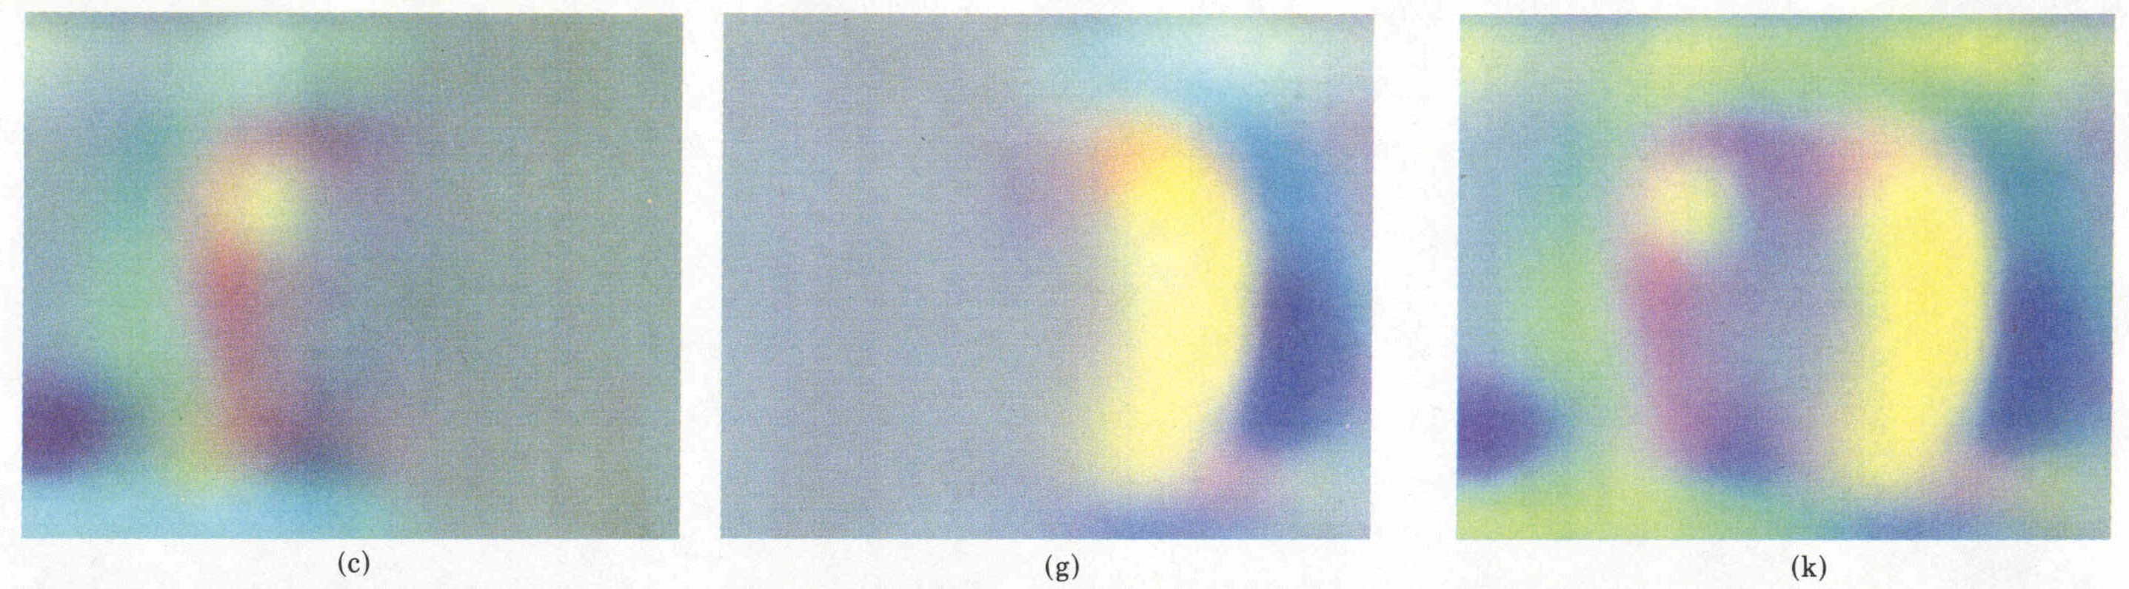
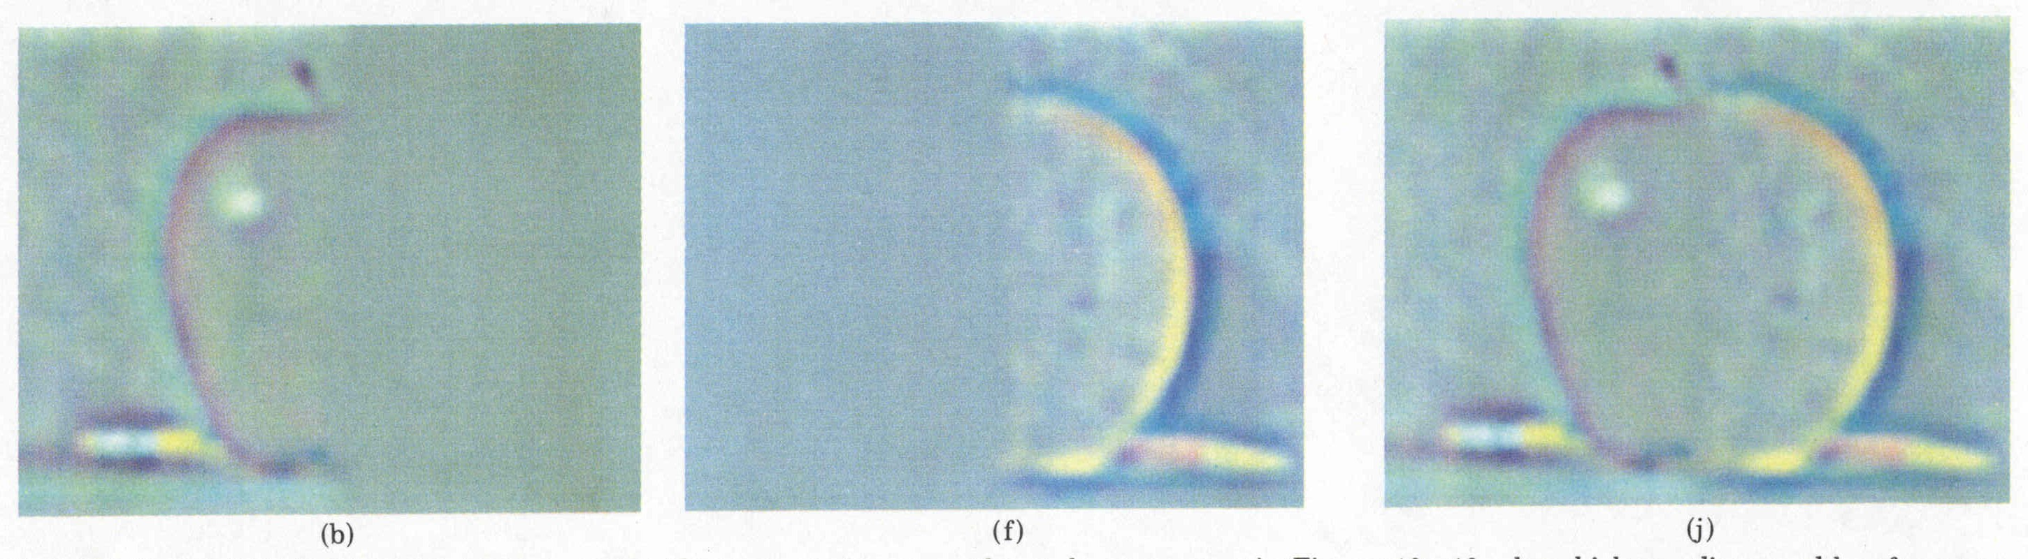
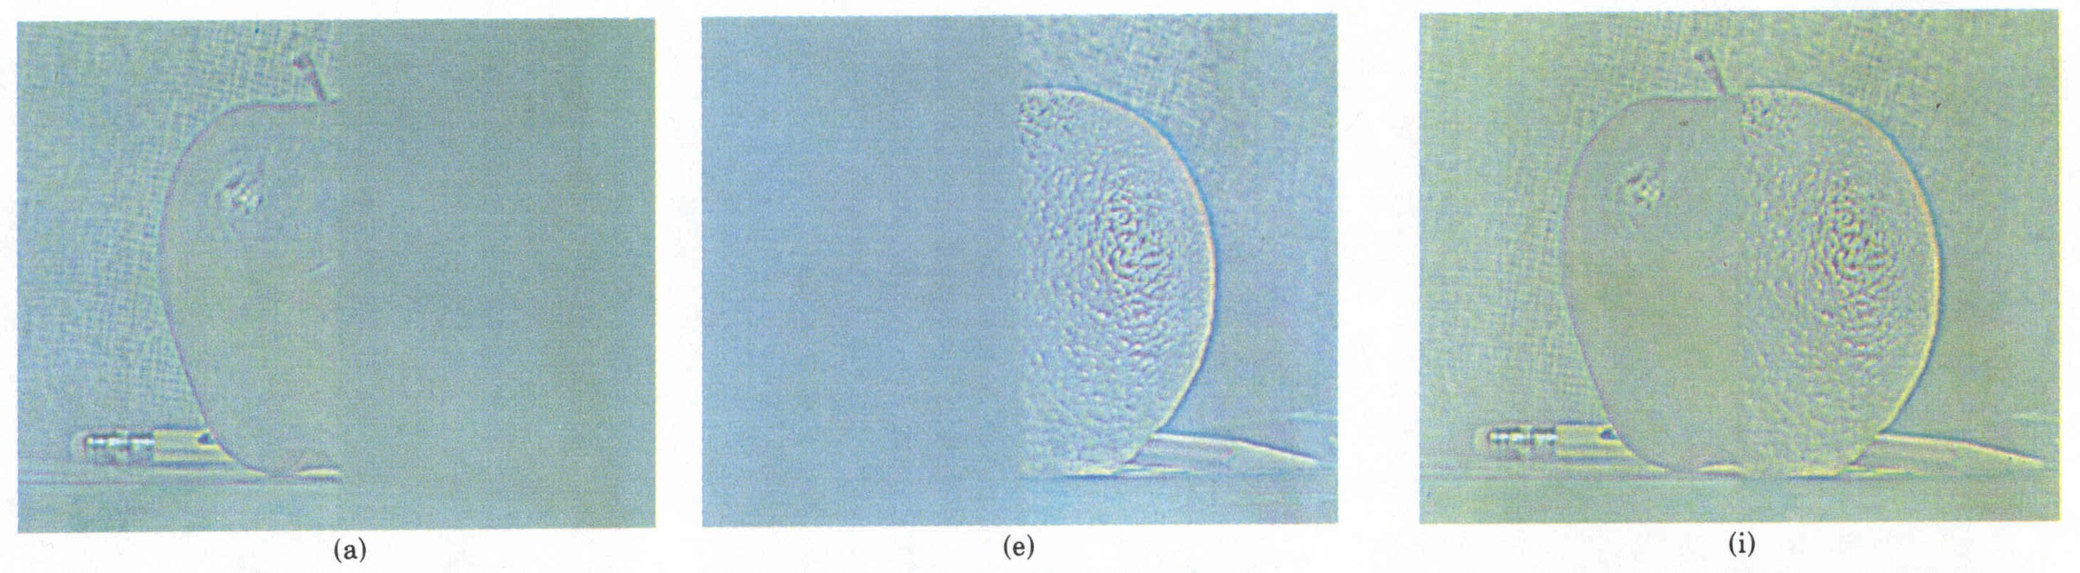
Laplacian
level
4
Laplacian
level
2
Laplacian
level
0
left pyramid
right pyramid
blended pyramid

Slide 38
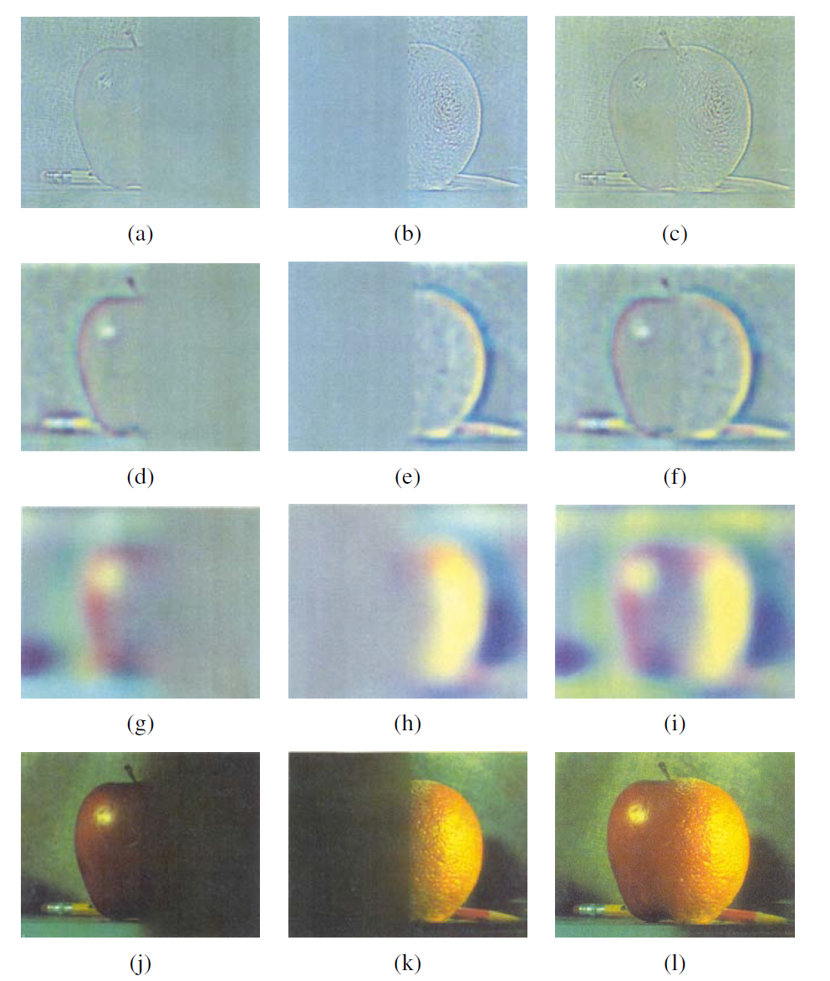
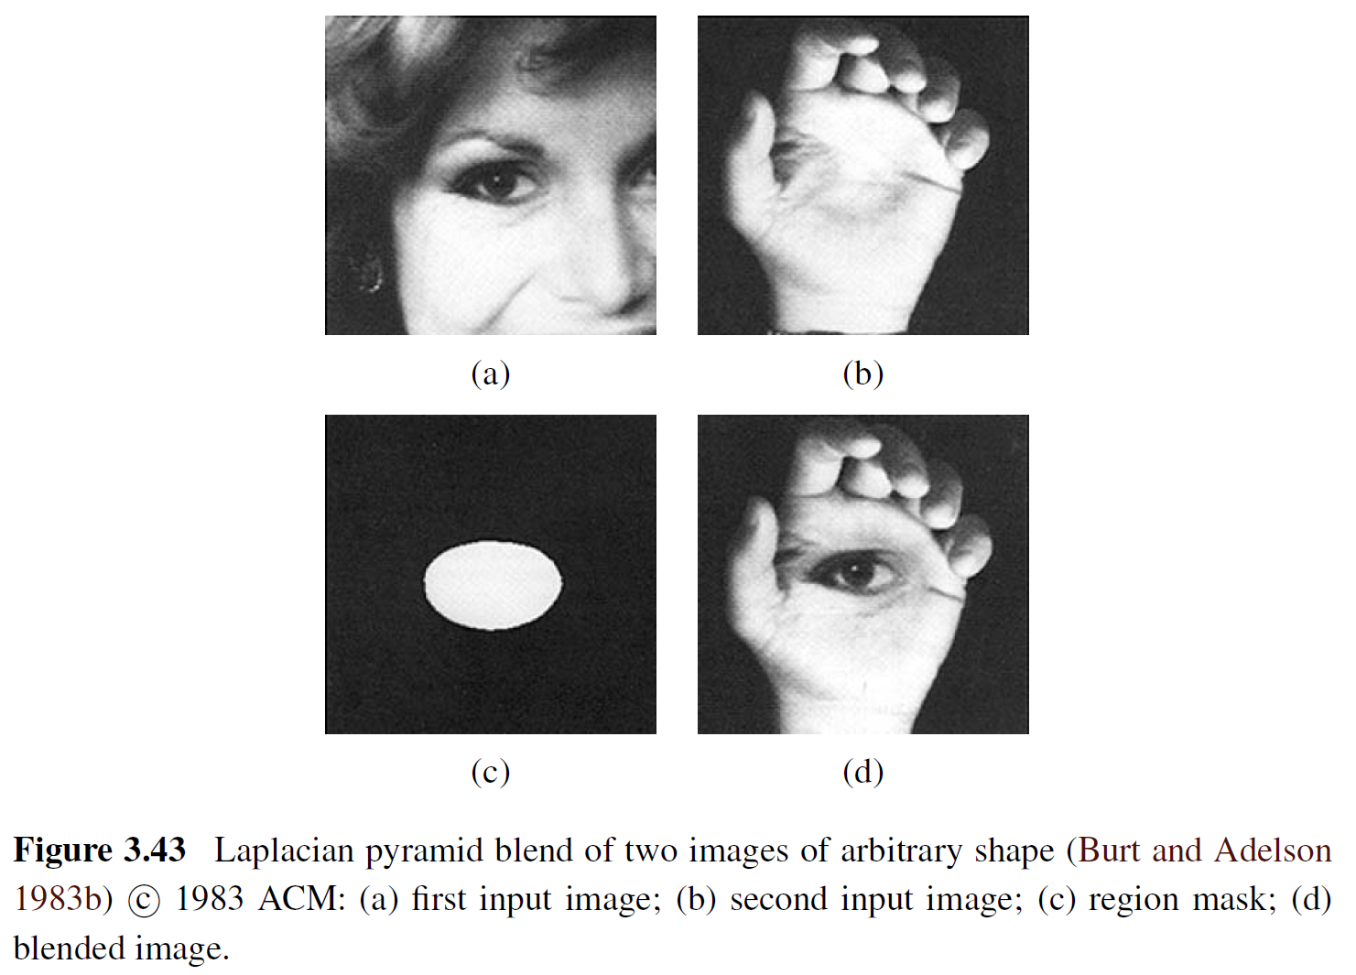
Laplacian pyramid blending

